Slide 1


Data Engineer Working Student
Building ETL
pipeline
With PostgreSQL and DBT
Master Data Science at University of Mannheim
Experienced with Azure Databricks, SQL Server, PySpark
Database Design
Nhat Nguyen Anh
Mannheim, Germany 06.04.2024

Slide 2
1
Environment Setup
2
Requirements Analysis
Agenda
3
Implementing
4
Result and future work

Slide 3
1
Environment Setup
2
Requirements Analysis
Agenda
3
Implementing
4
Result and future work

Slide 4


Environment Setup
Integration Tool
Data Warehouse
2

Slide 5




Environment Setup
Reporting
Model
Data Warehouse
User
2

Slide 6
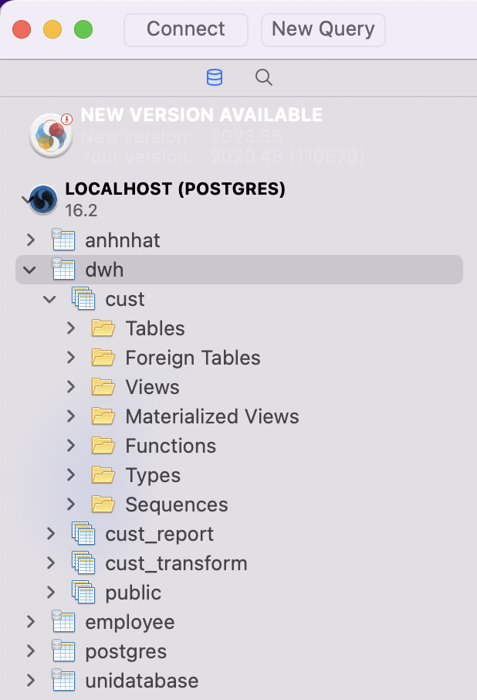
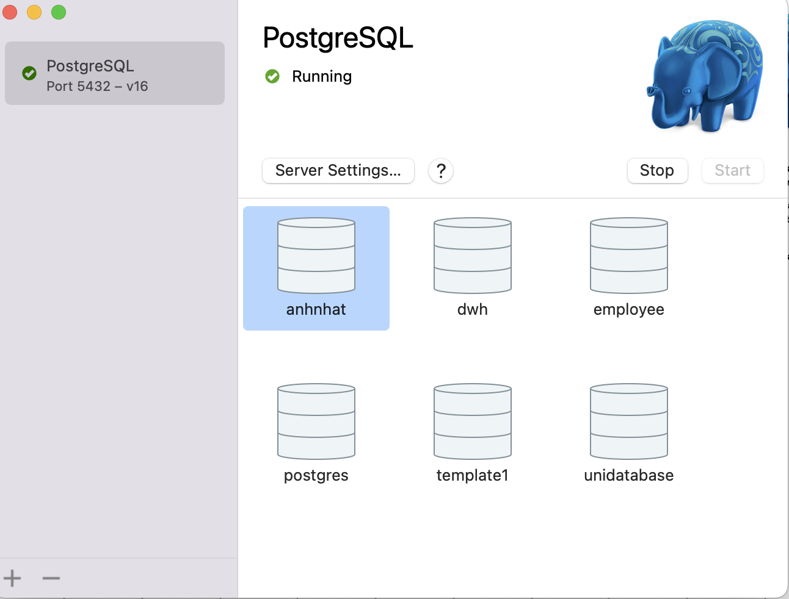
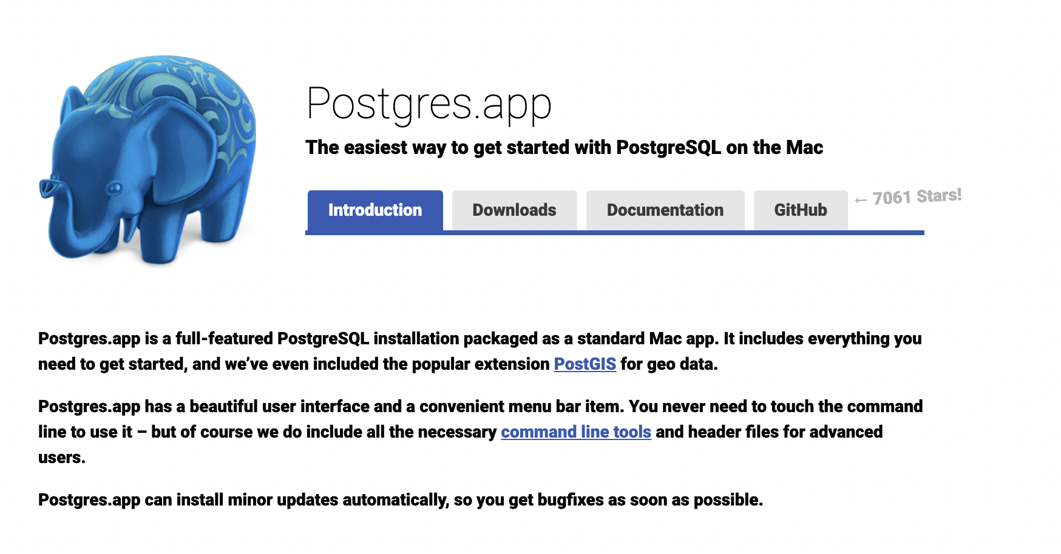
Environment Setup
Postgre App for Mac (portable)
IDE: SQLPro Studio
Database: dwh
2

Slide 7
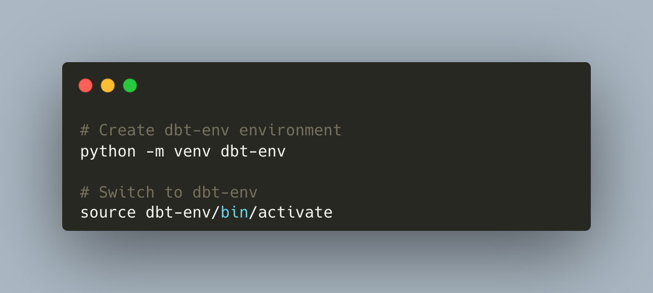
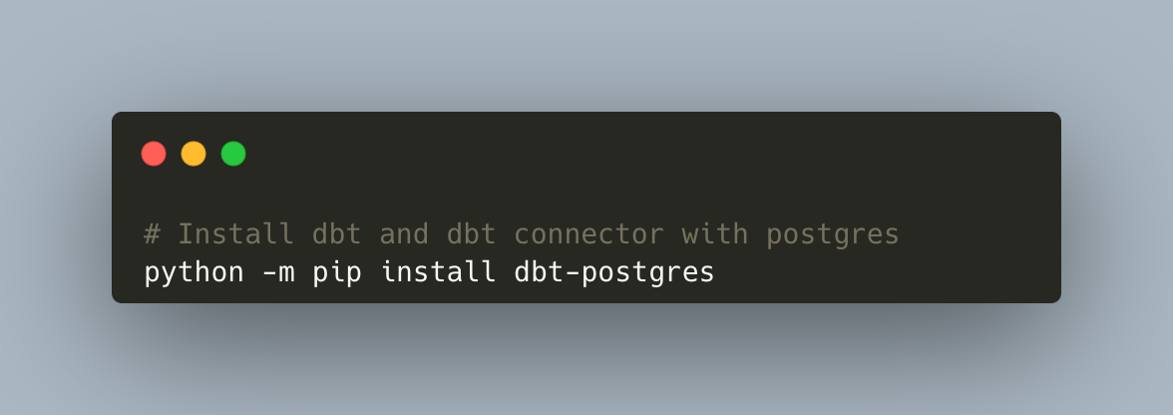
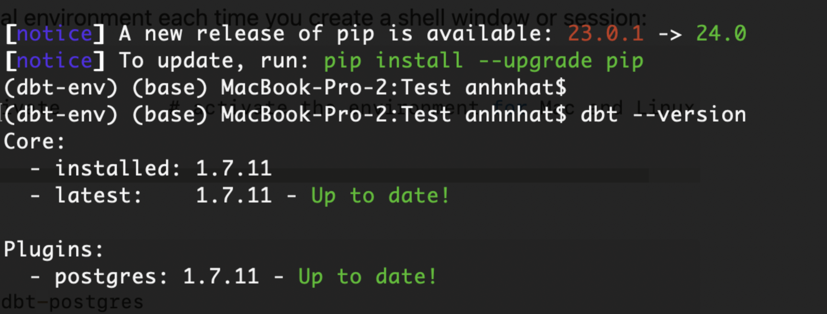
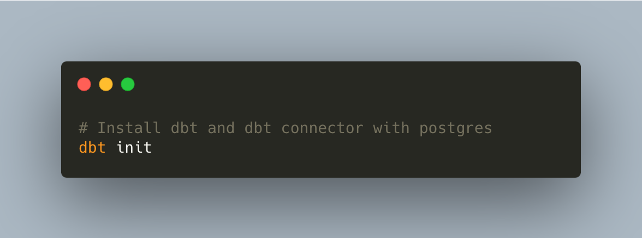
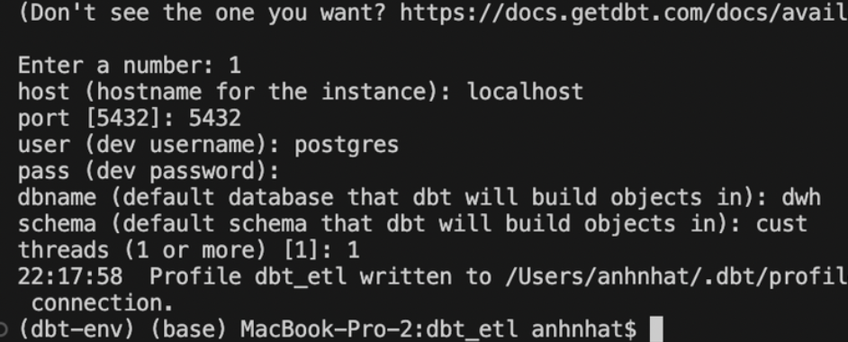
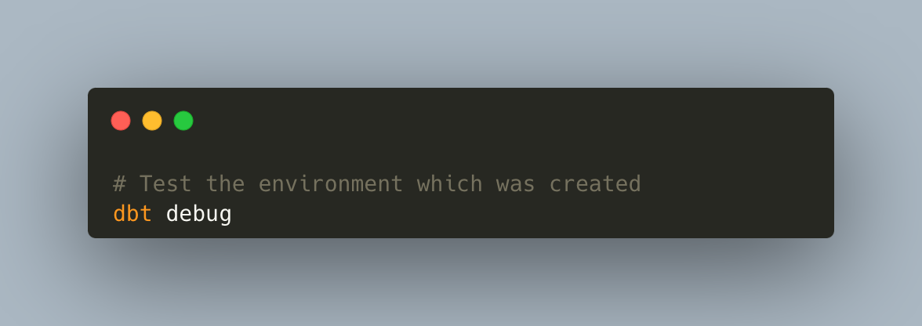
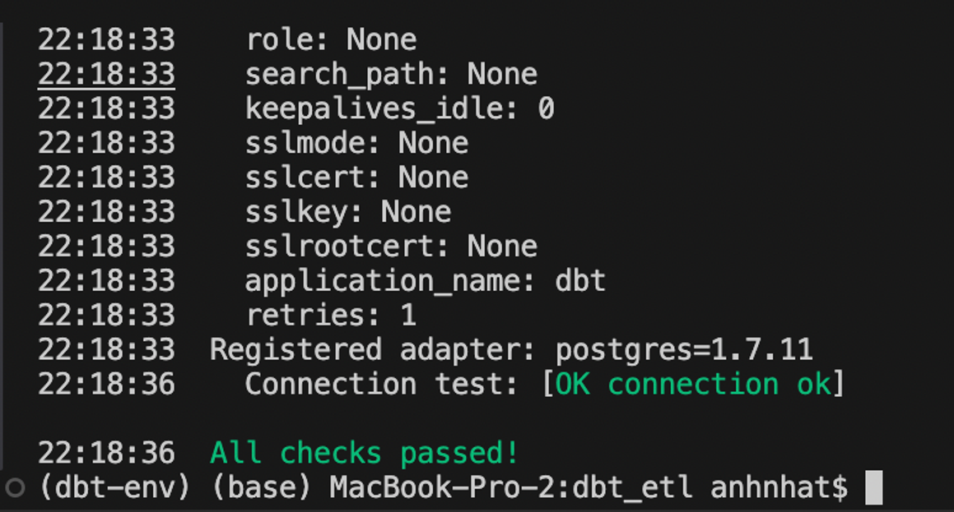
Environment Setup
IDE: Visual Studio Code
Setup python env and activate it
  Install dbt connector (with Postgre)
  Init dbt project with metadata and credential
  Test the environment
Seeds CSV data
2

Slide 8
1
Environment Setup
2
Requirements Analysis
Agenda
3
Implementing
4
Result and future work

Slide 9
1
Environment Setup
2
Requirements Analysis
Agenda
3
Implementing
4
Result and future work

Slide 10
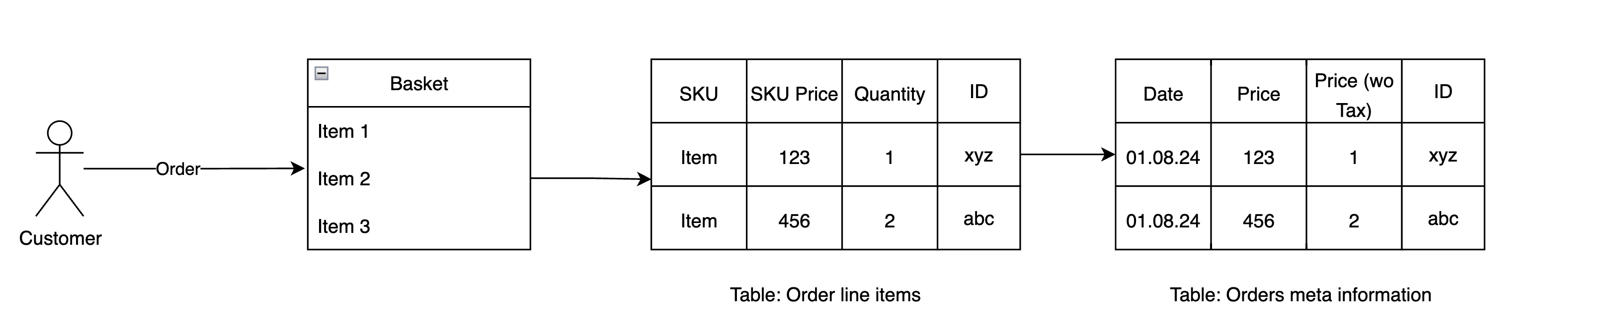
Requirements Analysis
Simple Data Flow Diagram
4

Slide 11
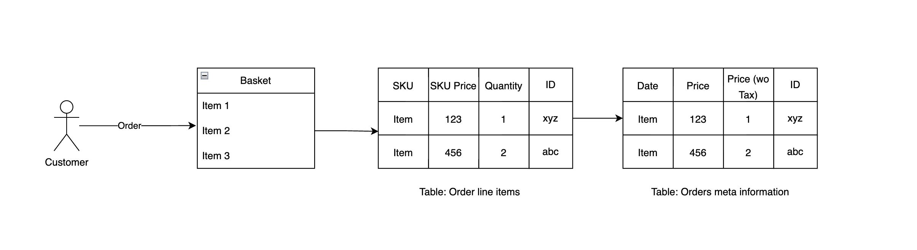
Requirements Analysis
Simple Data Flow Diagram
4

Slide 12
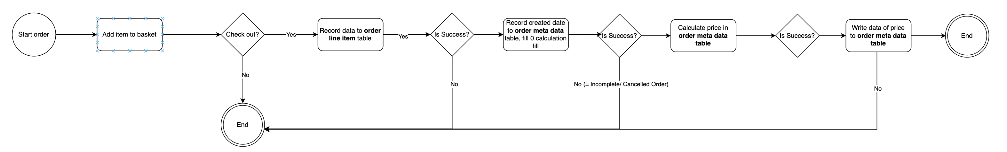
Requirements Analysis
Ordering Diagram
4

Slide 13
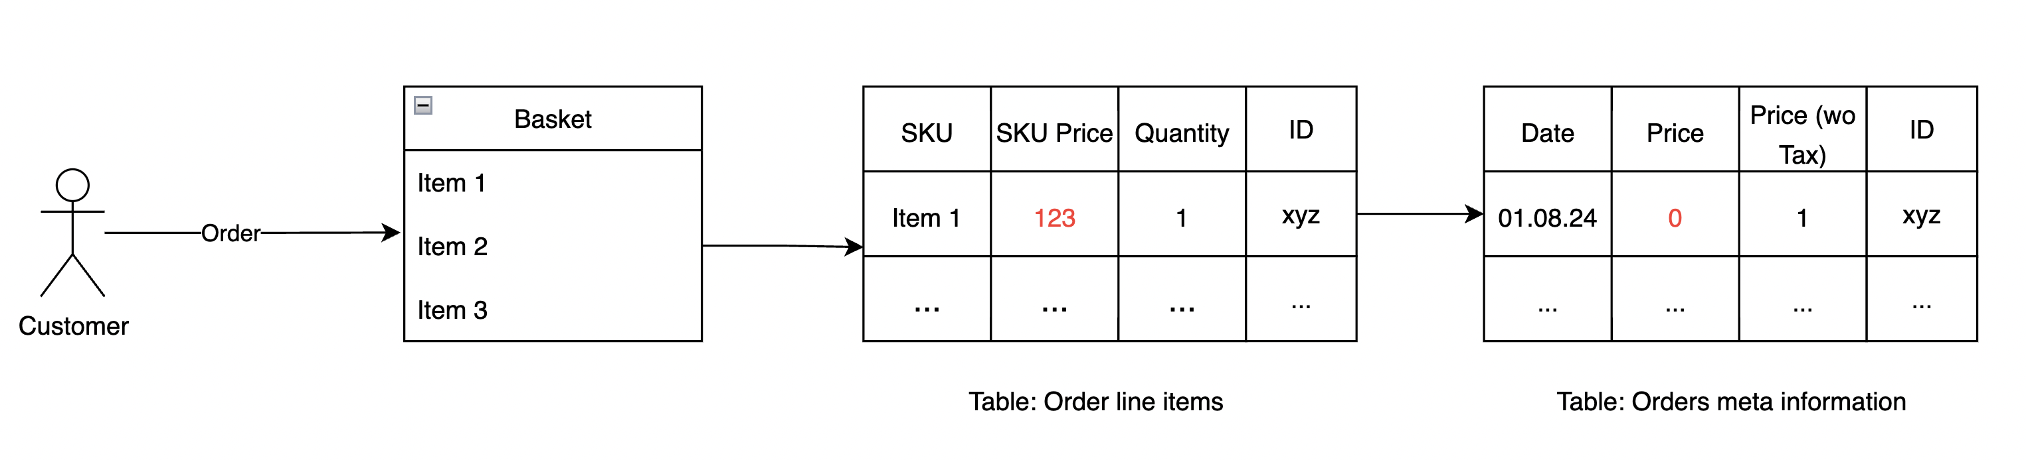
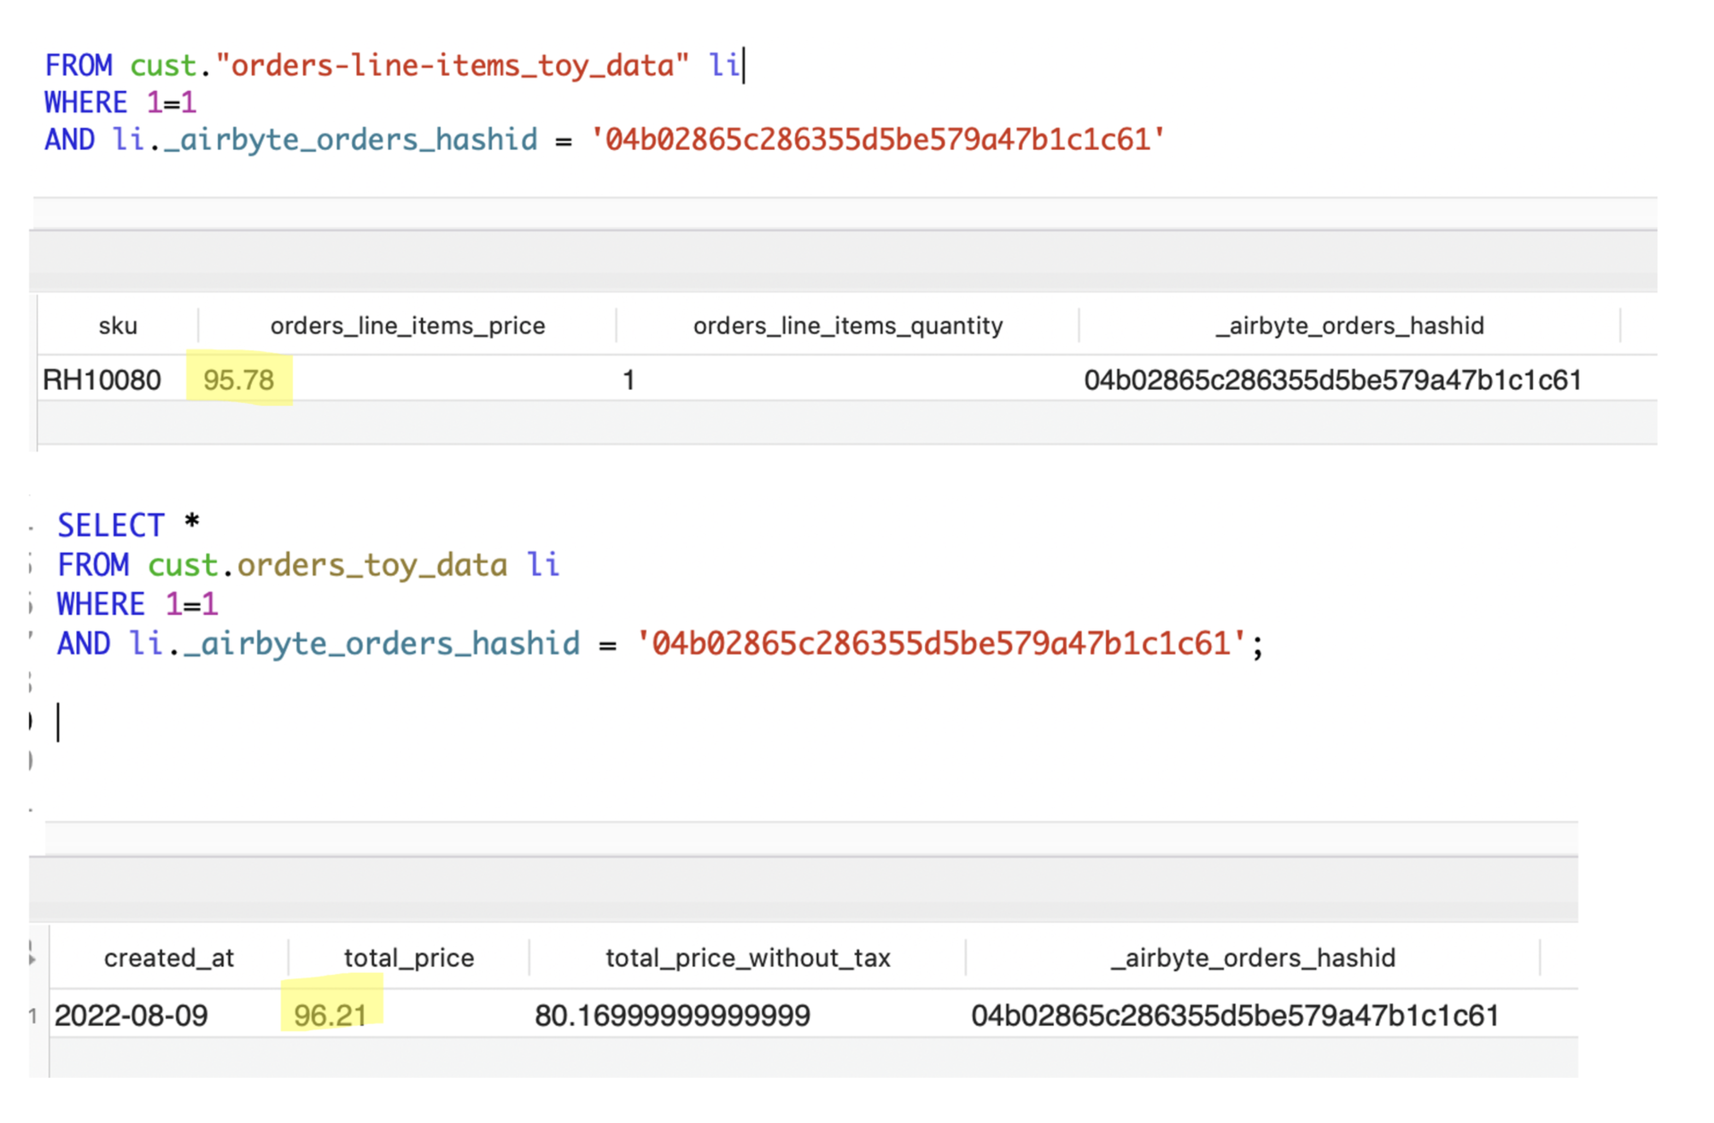
Requirements Analysis
Data quality:
An order in the Orders meta table has details in the Order line items table but does not have a total_price -> Assume it is an incomplete or cancelled order.
Data Consistency
Revenue is inconsistent between Orders meta (1) table and Order line items (2) table
  Revenue = SUM(Price) (1)
  Revenue = SUM(items_price * items_quantity) (2)
4

Slide 14
1
Environment Setup
2
Requirements Analysis
Agenda
3
Implementing
4
Result and future work

Slide 15
1
Environment Setup
2
Requirements Analysis
Agenda
3
Implementing
4
Result and future work

Slide 16


Implementing
Input
Output
Orders meta information
Aggregation table for daily reporting
Order line items
KPI:
  Margin per day = Revenue - Total cost of SKU in that order
  Total orders per day
Data Quality check (inconsistency)
Cost per SKU

Slide 17
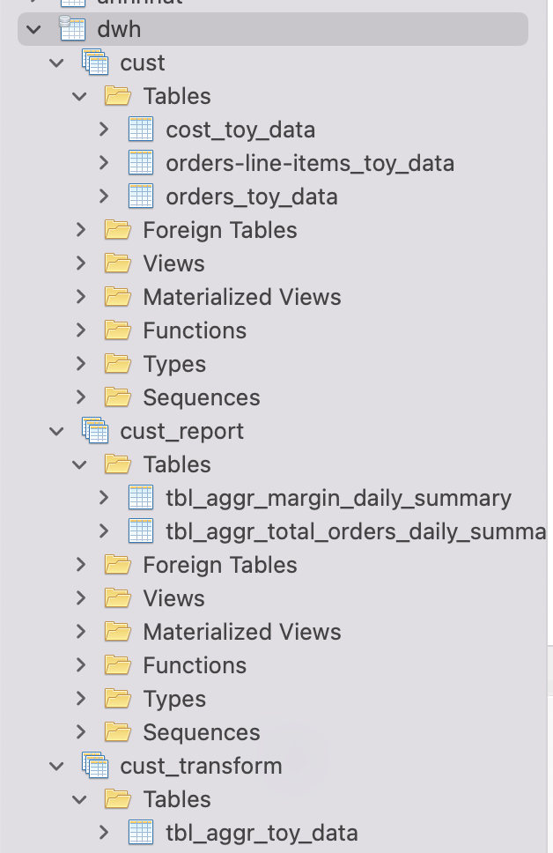
Implementing
Orders meta information
3 layers (schema) architecture
cust
cust_transform
cust_report
Order line items
dbt seed
Raw schema
Ingest directly from dbt seed
Transform schema
Aggregation table
Reporting schema
Reporting Layer
Cost per SKU

Slide 18
Implementing
3 layers (schema) architecture
cust
cust_transform
cust_report
Raw schema
Ingest directly from dbt seed
Transform schema
Aggregation table
Reporting schema
Reporting Layer
model_transform_table_toy.sql
model_report_margin.sql
model_report_total_orders.sql

Slide 19
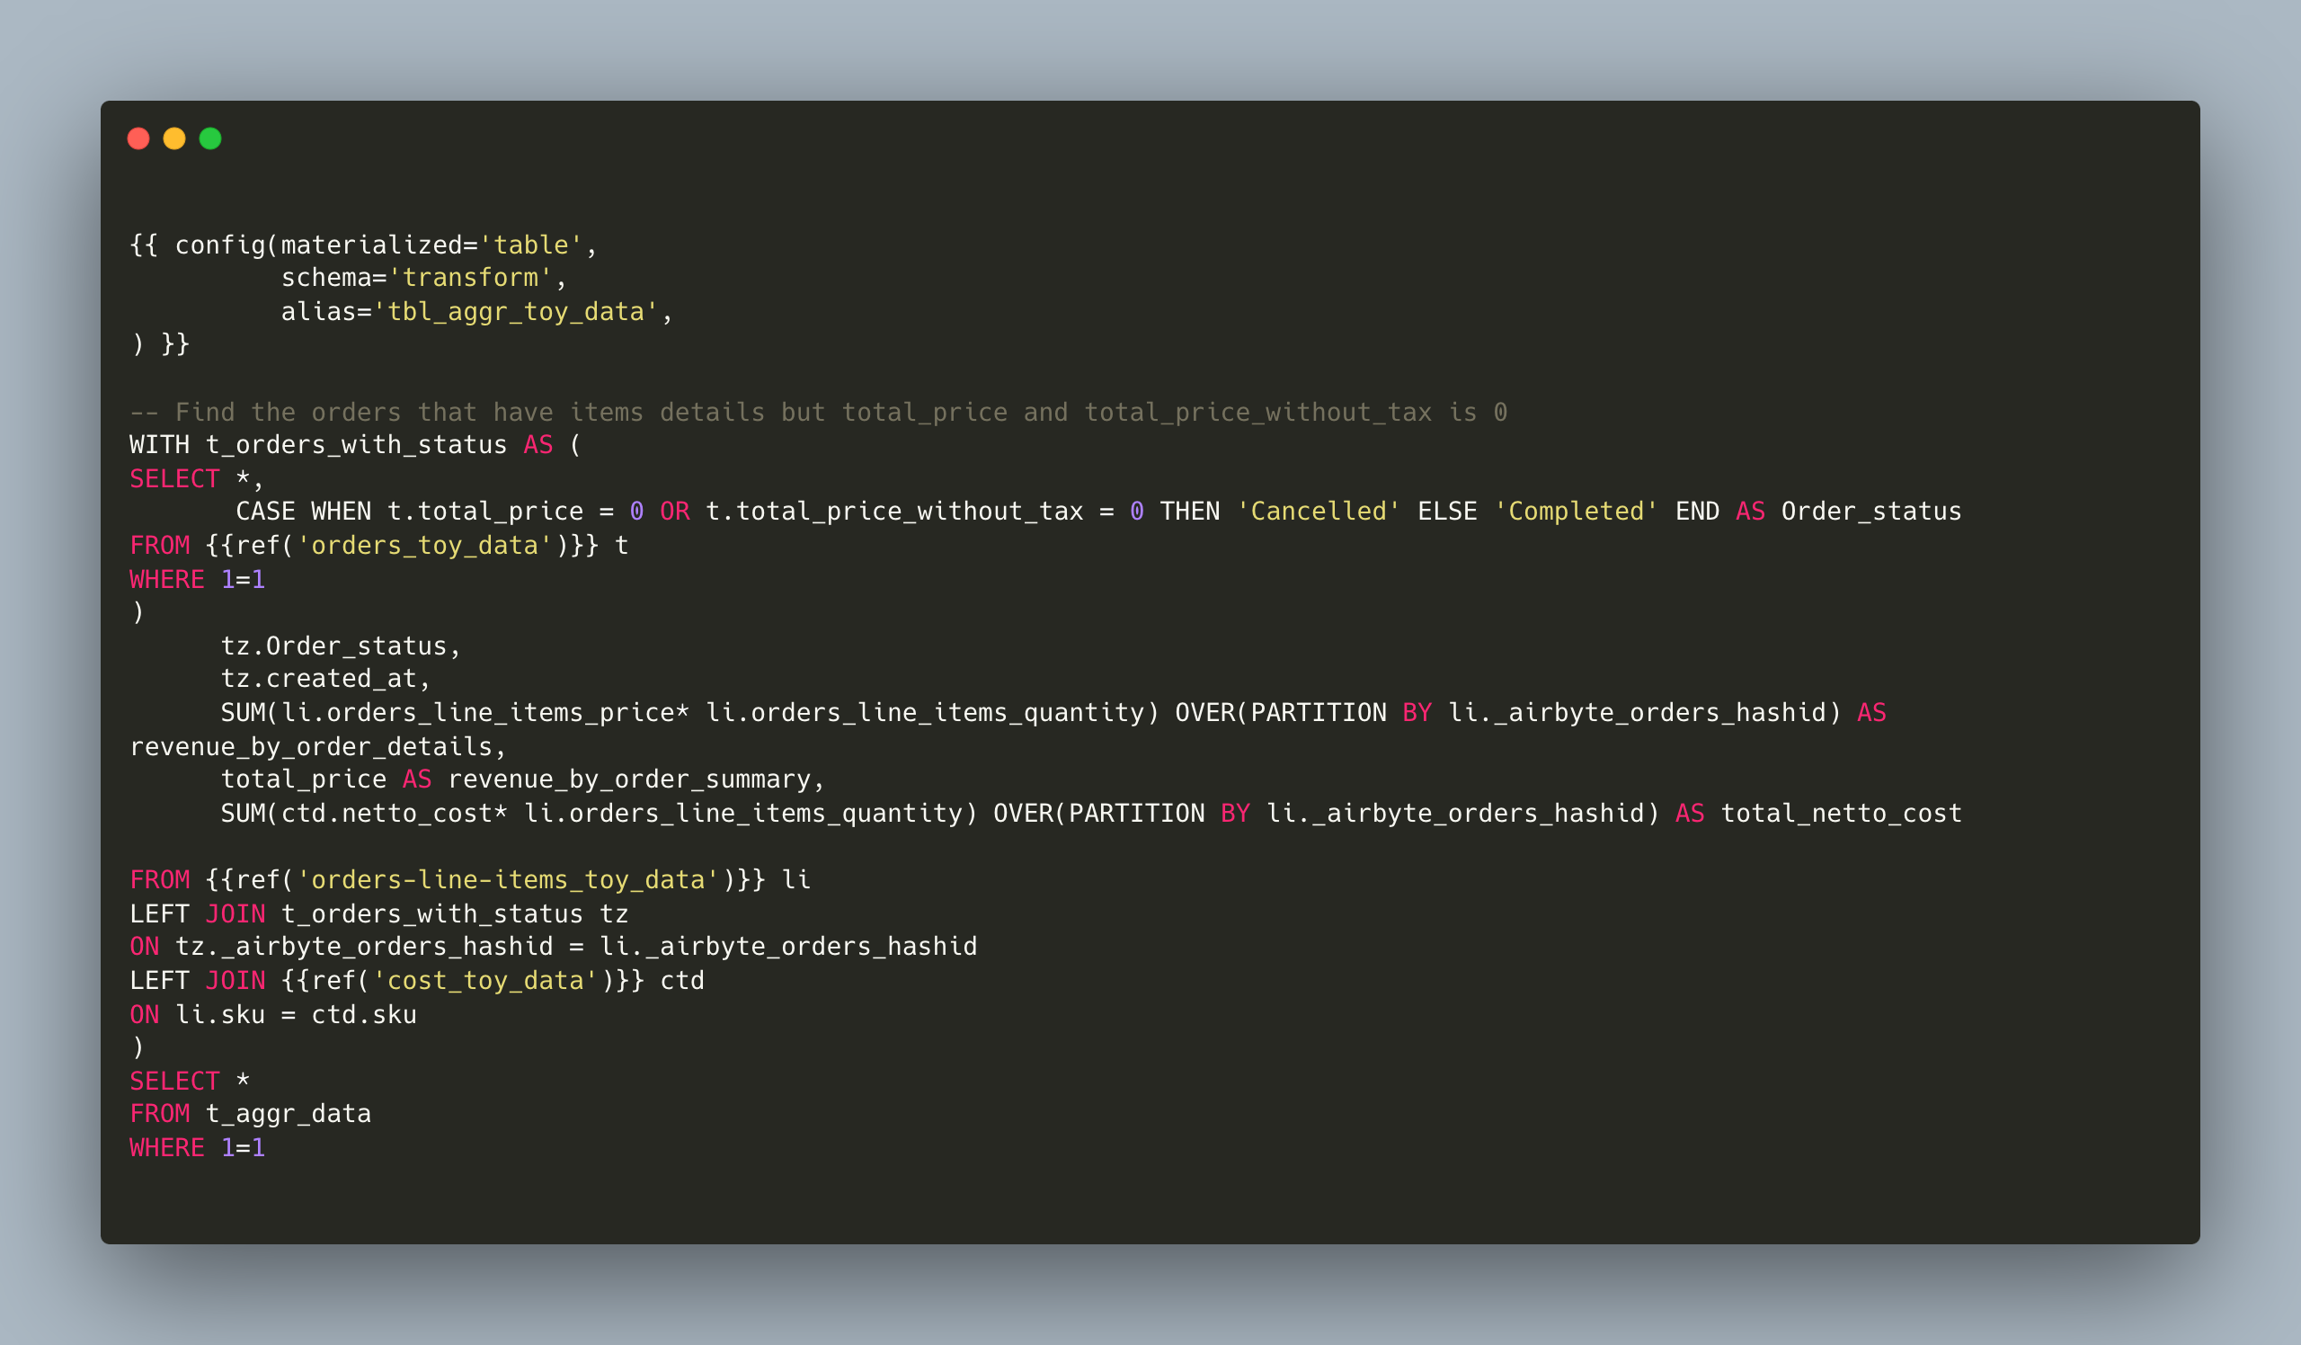
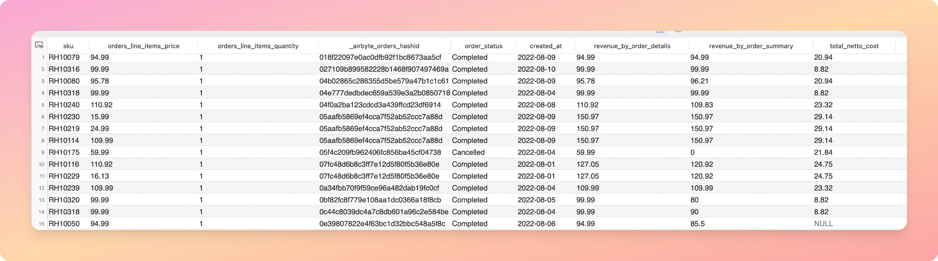
model_report_margin.sql
model_report_total_orders.sql
Implementing
model_transform_table_toy.sql
Figure 1: Transforming logic of table tbl_aggr_toy_data
Figure 2: Output of model in figure (1)

Slide 20
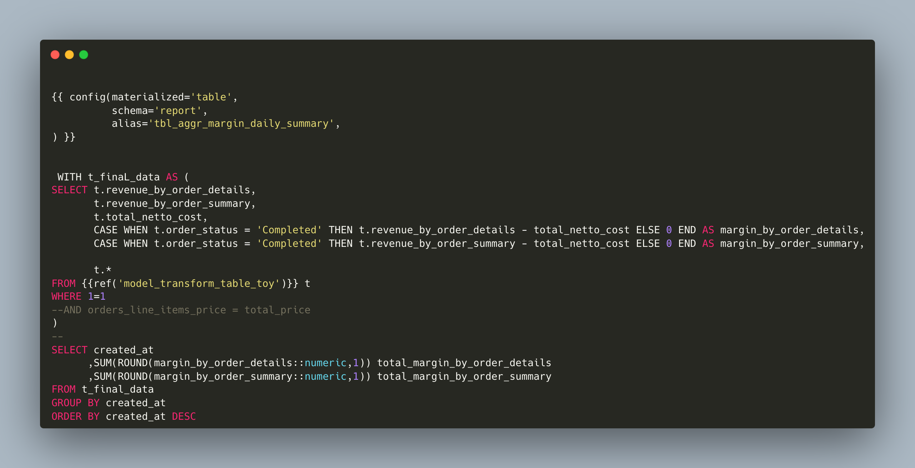
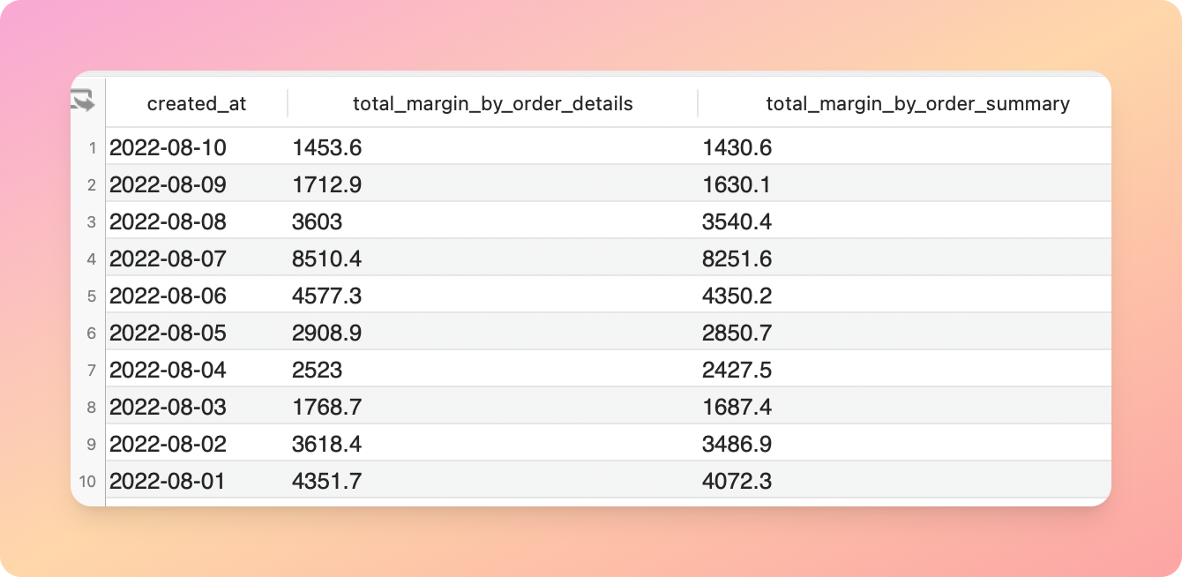
model_report_margin.sql
model_report_total_orders.sql
Implementing
model_report_margin.sql
Figure 1: Transforming logic of table tbl_aggr_margin_daily_summary
Figure 2: Output of model in figure (1)

Slide 21
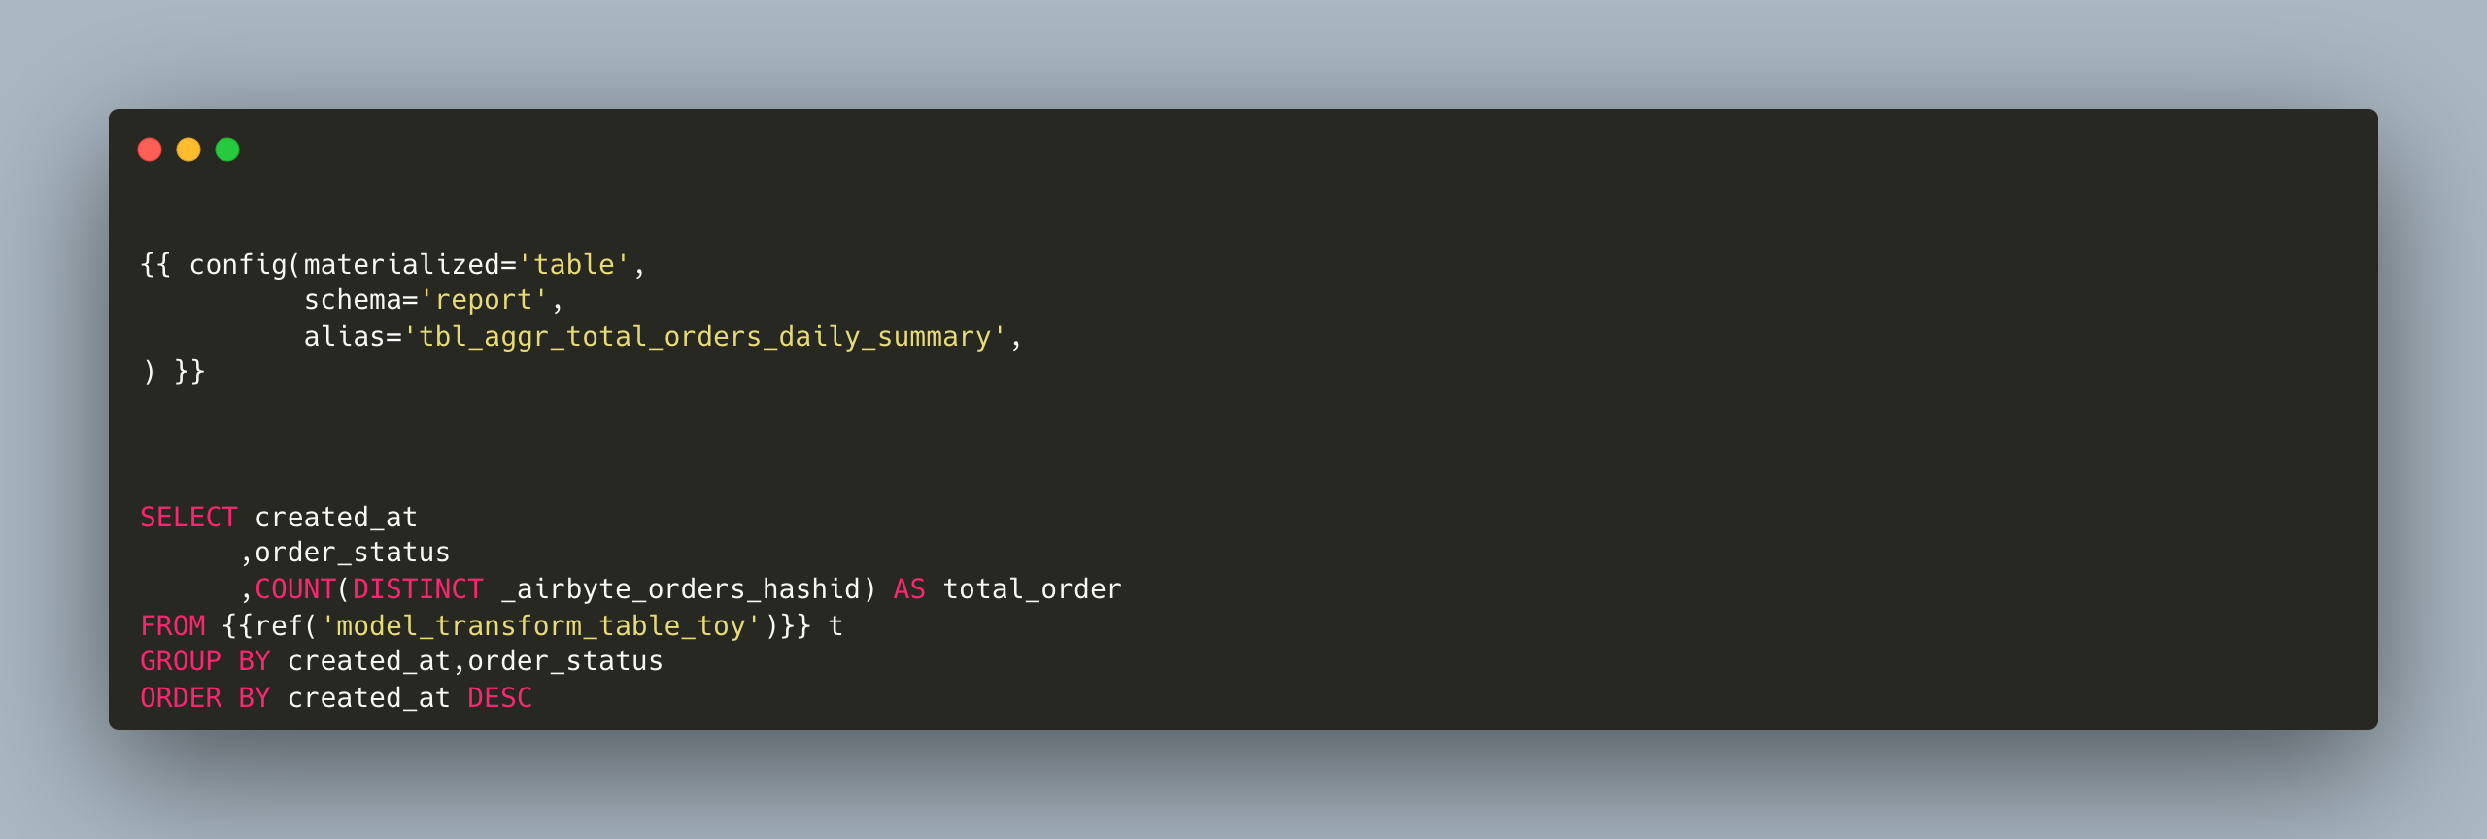
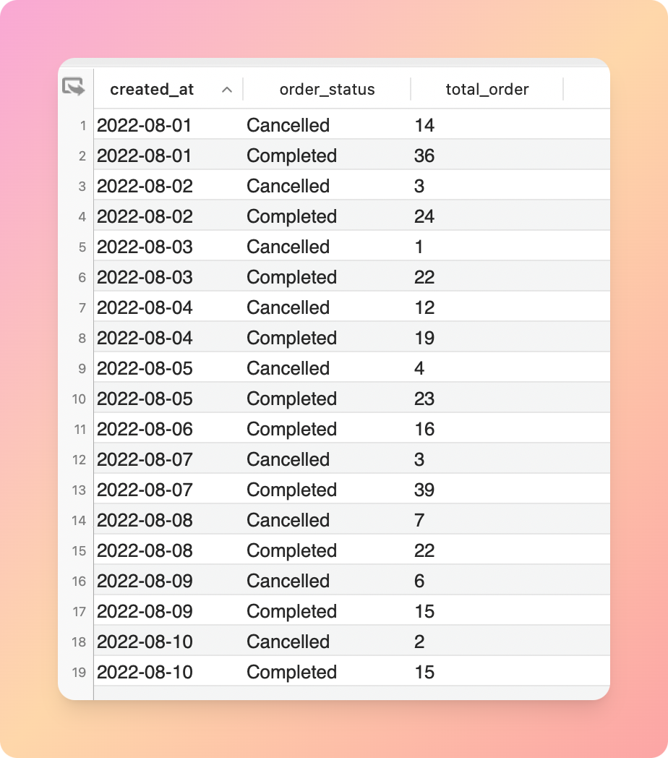
Implementing
model_report_total_orders.sql
Figure 1: Transforming logic of table tbl_aggr_margin_daily_summary

Slide 22
1
Environment Setup
2
Requirements Analysis
Agenda
3
Implementing
4
Result and future work

Slide 23
1
Environment Setup
2
Requirements Analysis
Agenda
3
Implementing
4
Result and future work

Slide 24
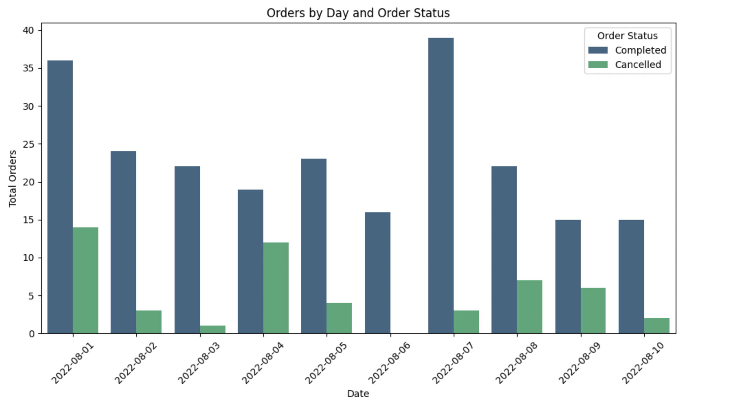
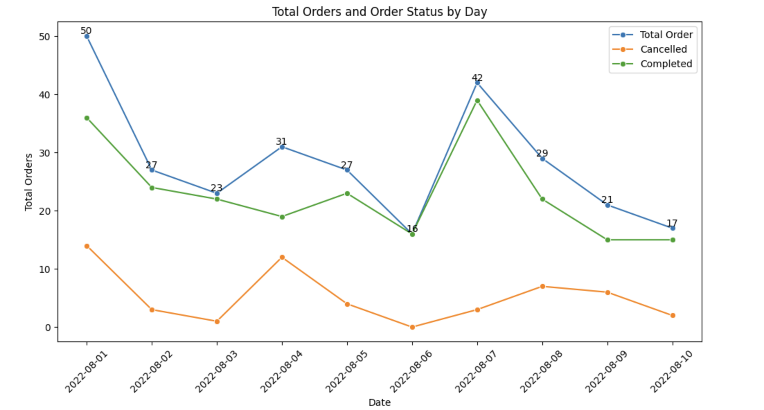
Result and FW
Total orders fluctuated over the 10-day period.
Cancelled orders peaked at 12 on 01 Aug and 10 on 04 Aug
4

Slide 25
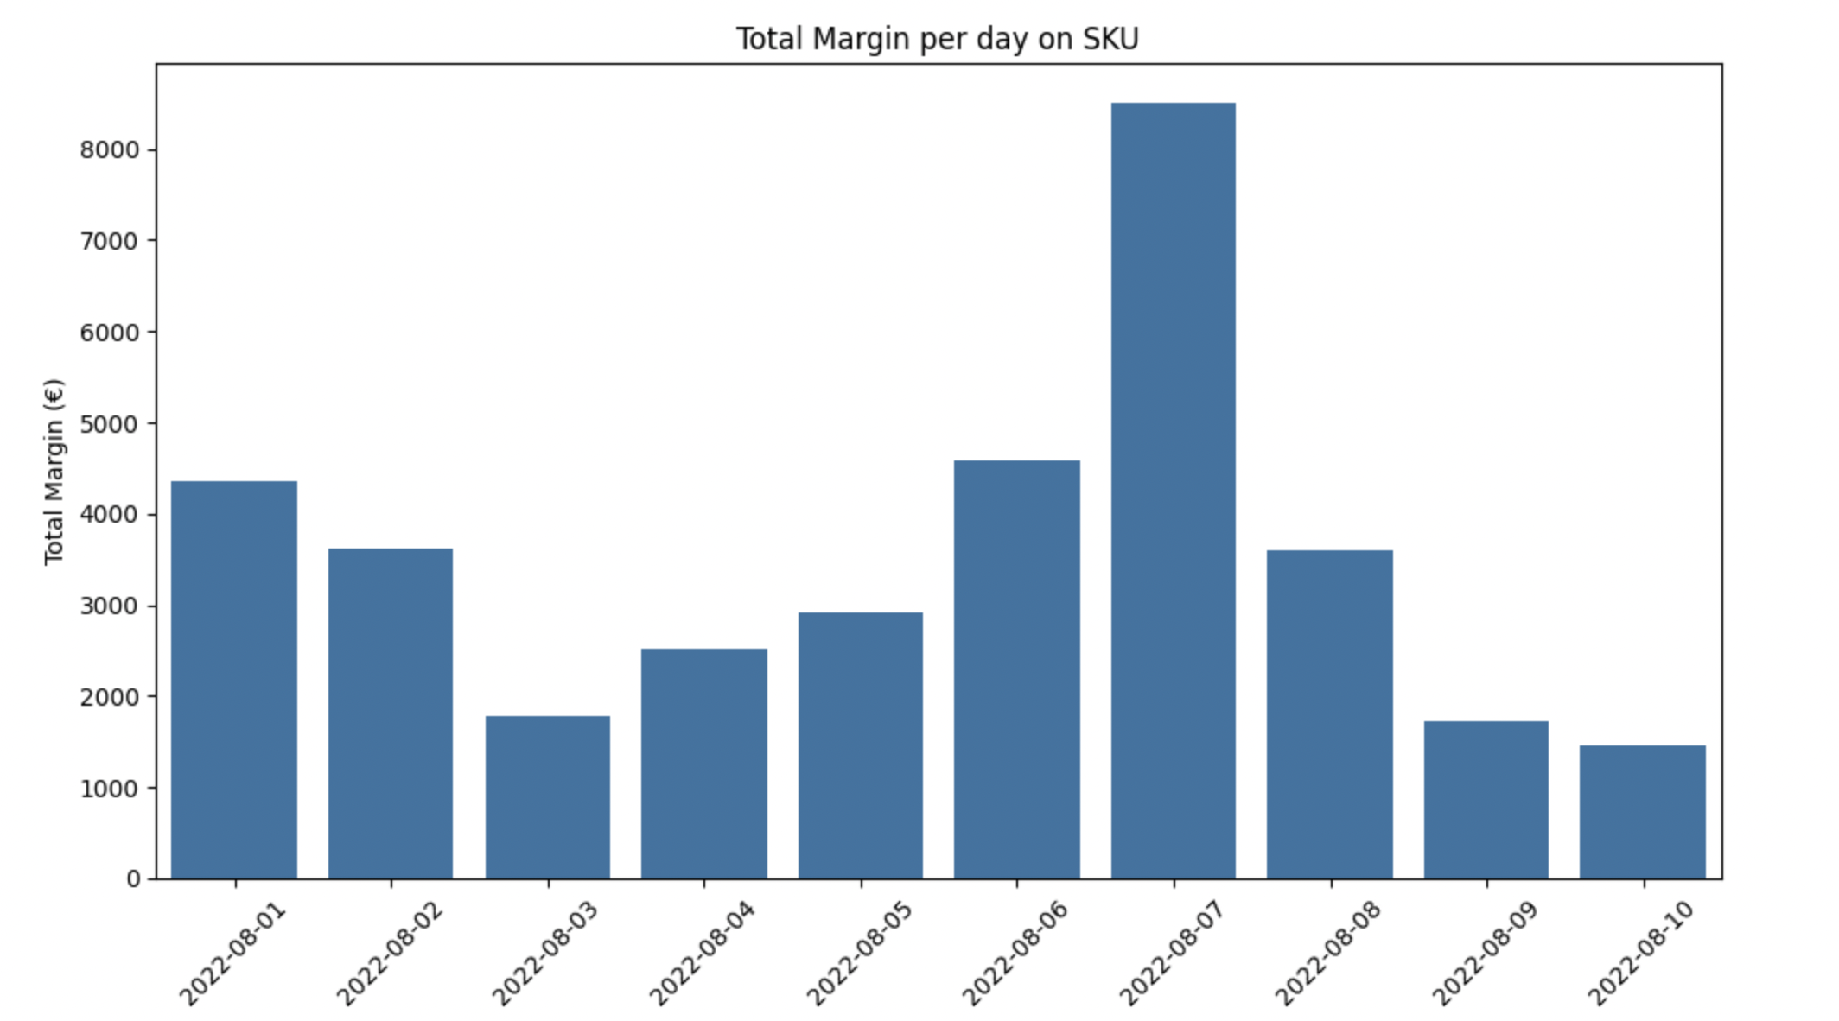
Result and FW
Margin revenue from completed orders was relatively stable over the 10-day period.
The highest margin was on 07 Aug 2024 at over €8k, while the lowest was around €2.5k on 03 Aug 2024
4

Slide 26
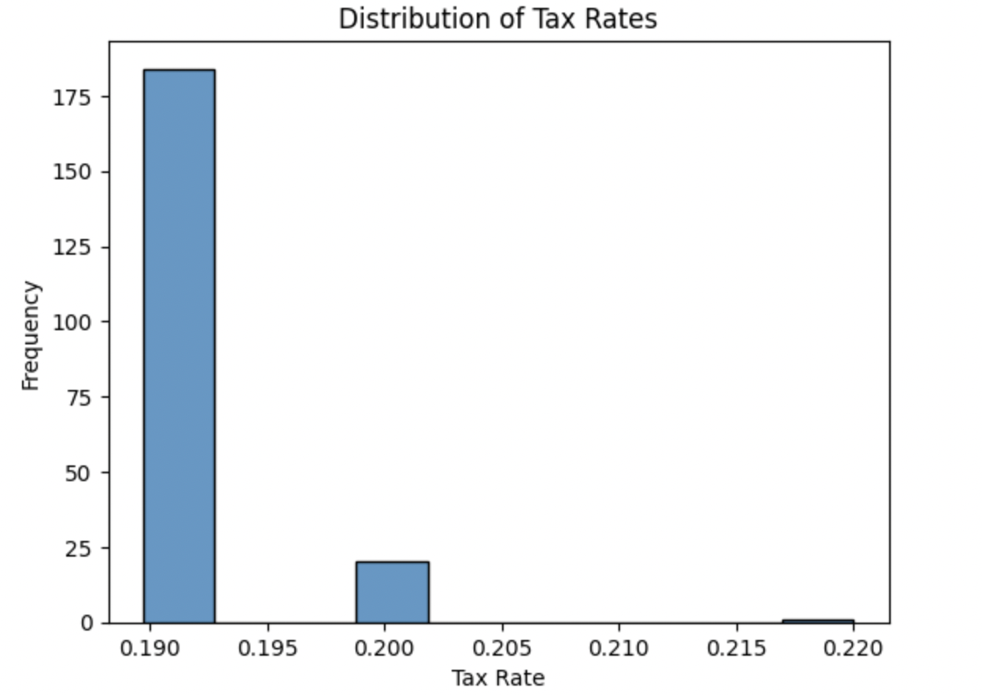
Result and FW
Appendix 1: Compare the tax rate of Order line item and Order meta as a data source
Tax rate by Order line item
Tax rate by Order meta
The data is sourced from two tables, and the histogram shows a similar distribution between the two sources, with around 19% of the data points reflecting the same tax rate => Cannot conclude any assumption about the data reliability
4

Slide 27

Thank you

